Slide 1

Unity For Academia
MonoBehaviour & Transforms
Spring 2025 – Week 5
Iman Noferesti

Slide 2
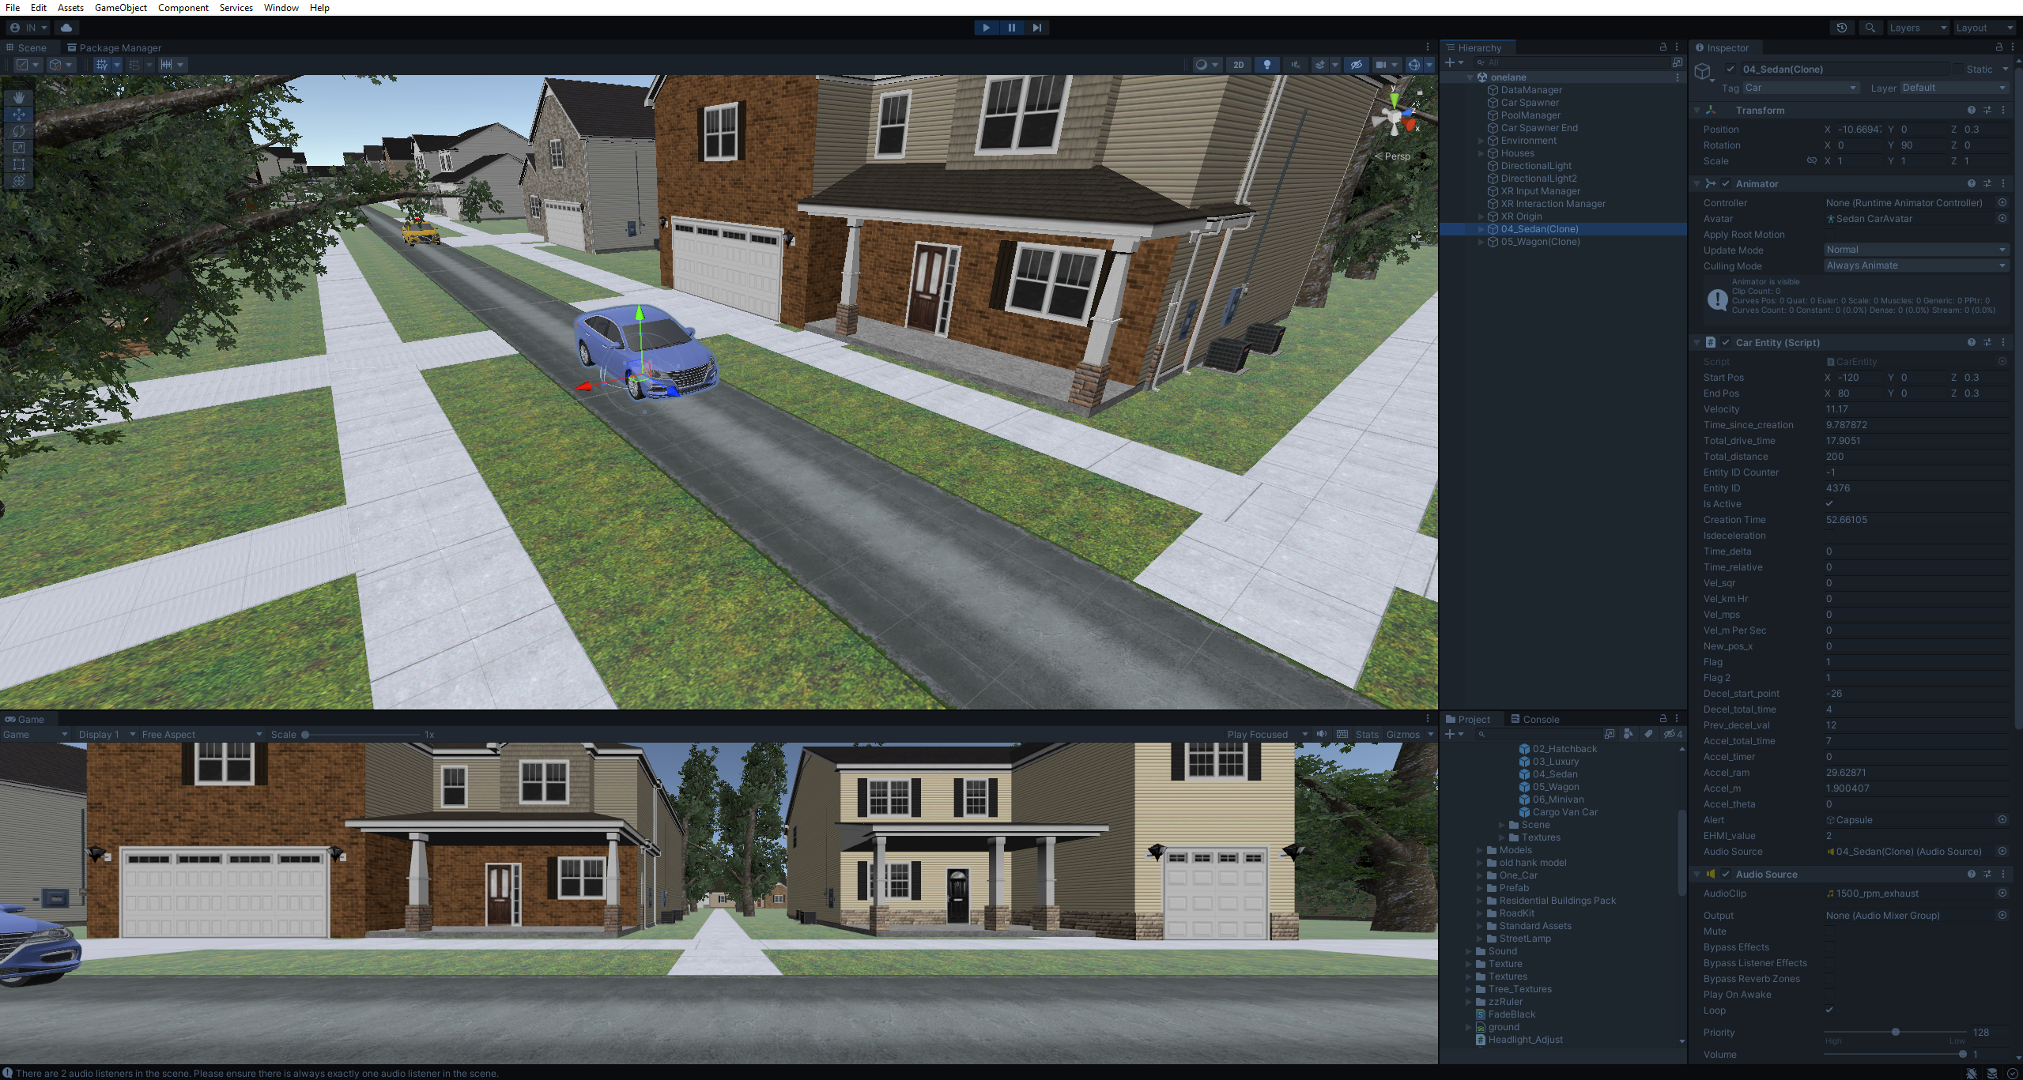
Unity’s Interface
1
The Toolbar offers access to your Unity Account and Unity Cloud Services, along with controls for Play mode, Undo history, Unity Search, a layer visibility menu, and the Editor layout menu.
The Hierarchy window displays a structured text list of all GameObjects within the Scene. It showcases how GameObjects are connected and organized in relation to one another.
The Inspector window lets you examine and modify the properties of the currently selected GameObject.
Since various GameObjects possess unique sets of properties, the layout and content of the Inspector window adapt each time a different GameObject is chosen.
2
3

Slide 3
Unity’s Interface
4
The Scene view enables you to navigate and modify your Scene visually. It supports both 3D and 2D perspectives, depending on the nature of the Project you are working with.
The Game view provides a preview of your game's final rendered appearance as seen through your Scene Cameras. The simulation starts when you press the Play button.
The Project window showcases your library of Assets that are accessible for use in your Project. Any Assets you import will be displayed in this window.
5
6

Slide 4
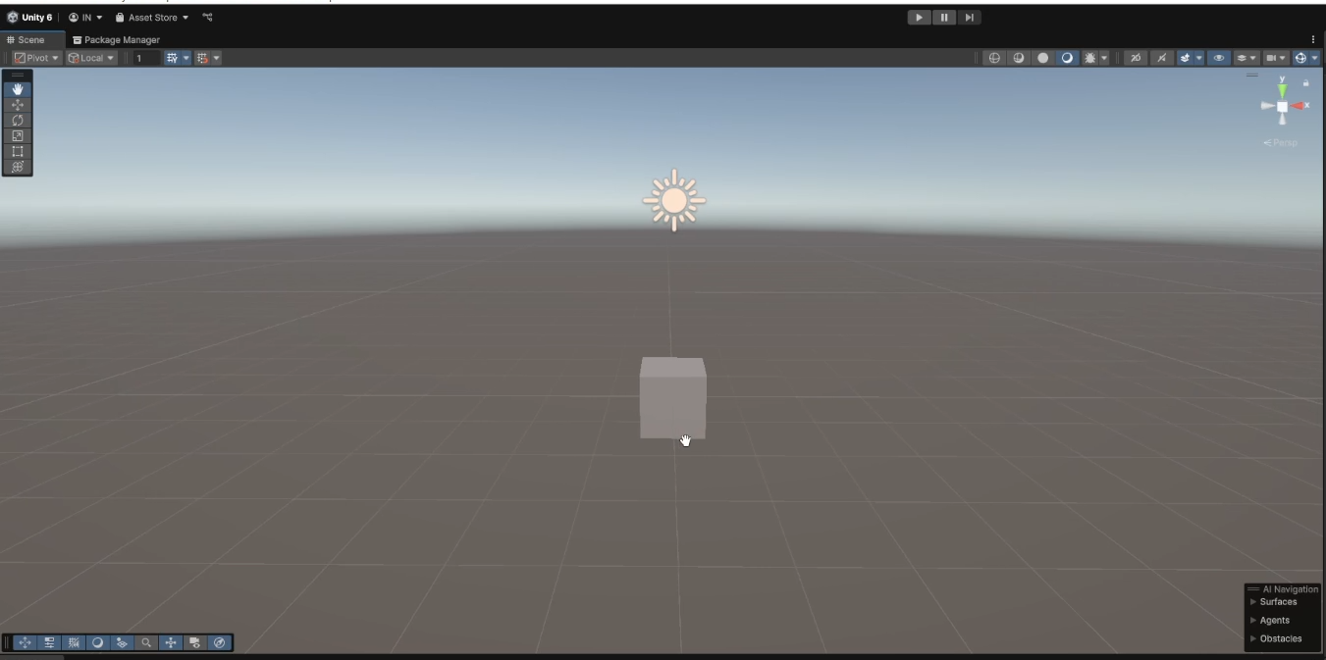
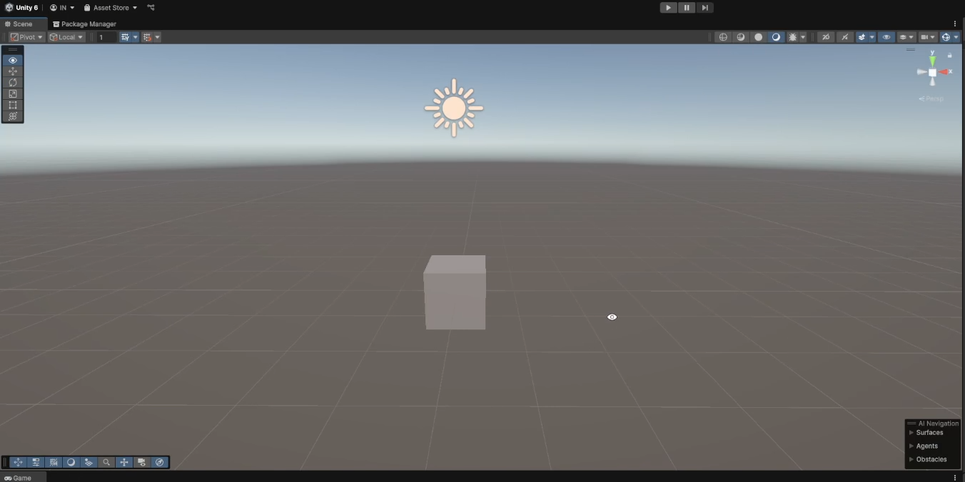
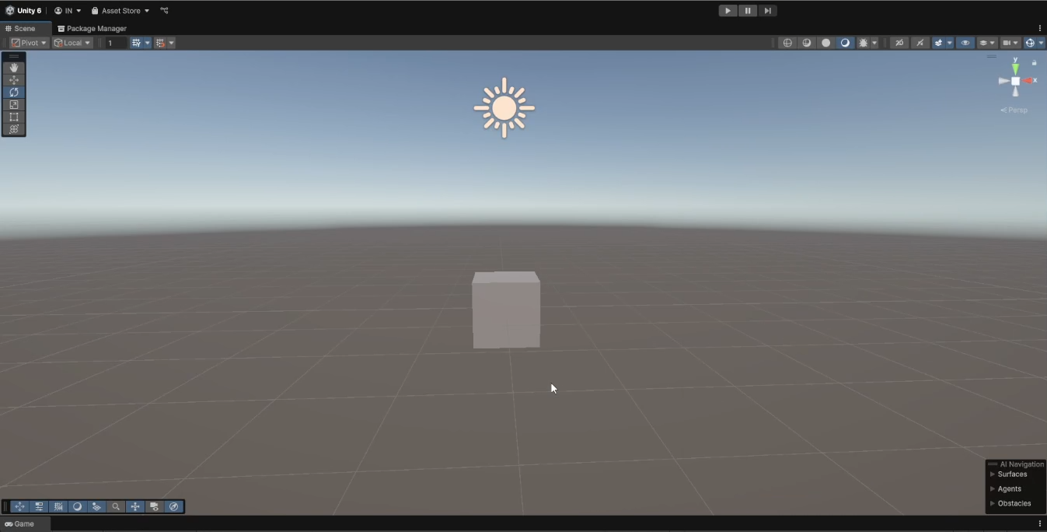
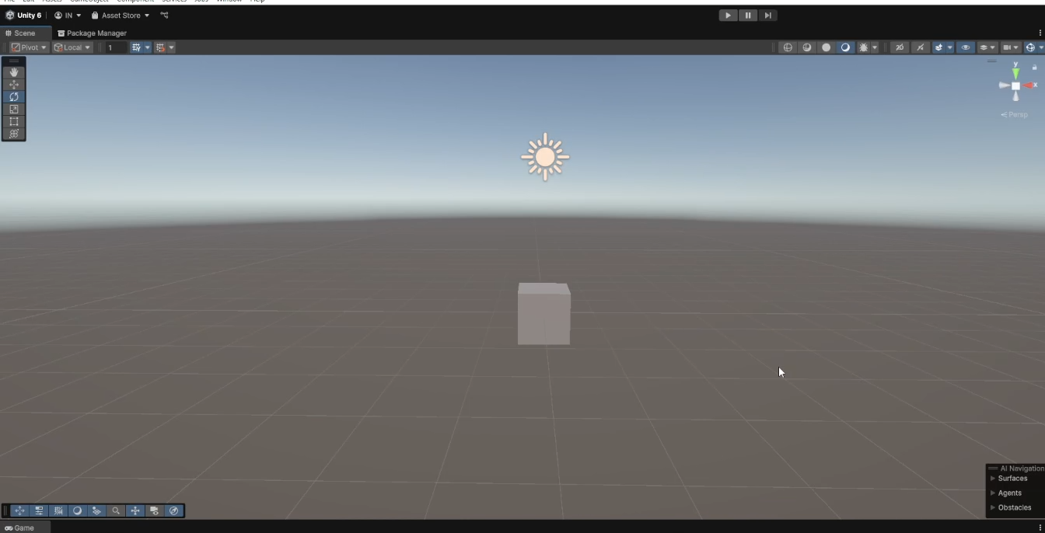
Scene View
Pan
Orbit
Zoom
Press and hold the mouse wheel to pan the camera.
Hold Alt (Windows) or Option (macOS), and left-click and drag to orbit the Camera around the current pivot point.
Use the mouse scroll wheel to zoom in and out.
To enter Flythrough mode and navigate through the Scene view in Flythrough mode:
Click and hold the right mouse button.
Do the following to navigate through the Scene view:
Use your mouse to move the view.
To move forward or backward, press W or S.
To move left or right, press A or D.
To move up or down, press Q or E.
Use the Flythrough mode to fly around the Scene view in first-person, similar to how you would navigate in many games.

Slide 5
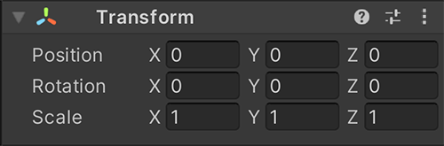
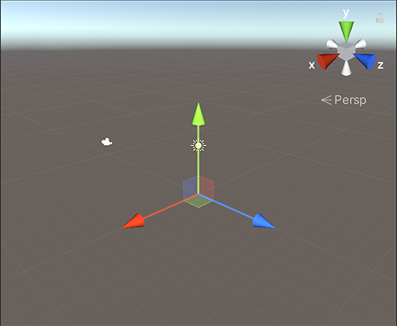
Transforms
The Transform component keeps track of a GameObject's Position, Rotation, Scale, and its relationship to parent objects.
Every GameObject comes with a Transform component by default, which cannot be removed or omitted when creating a GameObject.
Unity measures the Position, Rotation and Scale values of a Transform relative to the Transform’s parent.
If the Transform has no parent, Unity measures the properties in world space.
Editing Transforms:
Transforms can be adjusted along three axes: the x-axis, y-axis, and z-axis.
These axes are visually represented by the colors red, green, and blue, respectively.

Slide 6

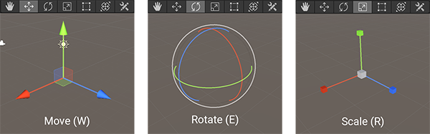
There are three primary ways you can edit a Transform’s properties:
In the Scene View
In the Inspector Window
In your C# Script
Scene View:
In the Scene view, Transforms can be adjusted using the Move, Rotate, and Scale tools, which are accessible in the top-left corner of the Unity Editor.
Inspector View:
In the Inspector window, the Transform component allows you to modify the Transform properties of a selected GameObject. You can edit these properties in two ways:
Manually input values into the property fields for precise adjustments.
Click and drag a value field up or down to change the value, which is ideal for less precise adjustments.
C# Script:
Transform API allows you to edit the Transform of a GameObject through script.
Scene View Image
Inspector View Image

Slide 7
Hierarchy
Property / Method | Description
*root | Returns the topmost transform in the hierarchy.
*parent | The parent of the transform.
DetachChildren() | Unparents all children.
*Find(string n) | Finds a child by name n and returns it.
*childCount | The number of children the parent Transform has.
*GetChild(int index) | Returns a transform child by index.
GetSiblingIndex() | Gets the sibling index.
IsChildOf(Transform parent) | Is this transform a child of parent?
*SetParent(Transform parent) | Set the parent of the transform.
SetSiblingIndex(int index) | Sets the sibling index.
SetAsFirstSibling() | Move the transform to the start of the local transform list.
SetAsLasSibling() | Move the transform to the end of the local transform list.

Slide 8
Rotation
Property / Method | Description
rotation | A Quaternion that stores the rotation of the Transform in world space.
localRotation | The rotation of the transform relative to the transform rotation of the parent.
eulerAngles | The rotation as Euler angles in degrees.
localEulerAngles | The rotation as Euler angles in degrees relative to the parent transform's rotation.
*LookAt(Transform target) | Rotates the transform so the forward vector points at /target/'s current position.
*Rotate(Vector3 eulers, Space relativeTo = Space.Self) *Rotate(float xAngle, float yAngle, float zAngle, Space relativeTo = Space.Self) *Rotate(Vector3 axis, float angle, Space relativeTo = Space.Self) | Use Transform.Rotate to rotate GameObjects in a variety of ways. The rotation is often provided as an Euler angle and not a Quaternion.
RotateAround(Vector3 point, Vector3 axis, float angle) | Rotates the transform about axis passing through point in world coordinates by angle degrees.

Slide 9
Position
Property / Method | Description
*position | The world space position of the Transform.
*localPosition | Position of the transform relative to the parent transform.
*Translate(Vector3 translation, Space relativeTo = Space.Self) | Moves the transform in the direction and distance of translation.
Scale
Property / Method | Description
*localScale | The scale of the transform relative to the GameObjects parent.

Slide 10
MonoBehaviour
Awake()
MonoBehaviour is the base class from which all scripts that interact with Unity’s engine must derive.
It provides built-in methods and lifecycle events that allows you to control game objects, handle input, and manage physics, rendering, and more.
Important Lifecycle Events:
Awake(): Called when the script instance is loaded.
OnEnable(): Called when the object/script is enabled.
Start(): Called before the first frame update.
FixedUpdate(): Called at a fixed interval (used for physics calculations).
OnTriggerEnter(Collider other): Called when another object enters a trigger collider.
OnCollisionEnter(Collision collision): Called when two objects collide.
Update(): Called every frame (used for movement, input handling).
LateUpdate(): Called after Update() (used for camera follow logic).
OnApplicationQuit(): Called when the application is closing or stopping.
OnDisable(): Called when the object/script is disabled.
OnDestroy(): Called just before the object is destroyed.
Initialization
OnEnable()
Start()
FixedUpdate()
Frame Updates
Update()
LateUpdate()
OnApplicationQuit()
Decommissioning
OnDisable()
OnDestroy()

Slide 11
